Slide 1
Analysis of Crime Incident from SFPD Reporting

Slide 2
Summary of Goals
WHAT:
Unravelling crime patterns and trends to better understand the safety level and categories of incidents that occur in different areas in SF.
WHY:
Stay vigilant on safety and security as SF continues to grow as a desirable city to live with thriving industry.
Provide insight to SF residents, guests and businesses on criminal activity in the area.
HOW:
Using crime data from various years to look at Crime Distribution:
Yearly, monthly, daily and hourly.
Crime Trends:
Most afflicted districts, most common crimes, unresolved crimes by district
More info about data at https://data.sfgov.org/Public-Safety/-Change-Notice-Police-Department-Incidents/tmnf-yvry
Data Provided by City and County of San Francisco. Incidents are derived from SFPD Crime Incident Reporting system. Updated on a daily basis; data available from 1 Jan 2003 up until two weeks from current date.
Notes:
Incidents are derived from SFPD Crime Incident Reporting system. Updated on a daily basis;data available from 1 Jan 2003 up until two weeks from current date.

Slide 3
Data Exploration
Data.sfgov.org
Incidents derived from SFPD Crime Incident Reporting system Updated daily, showing data from 1/1/2003 up until two weeks ago from current date.
Please note:
San Francisco police have implemented a new system for tracking crime. The dataset included here is still coming from the old system, which is in the process of being retired (a multi-year process). Data included here is no longer the official SFPD data.
File Volume
Rows 2.19M
Columns 13
Each row is an Incident
Columns Names
Incidnt Num
Category
Descript
Day Of Week
Date
Time
Pd District
Resolution
Address
X Y
Location
Notes:
As of July 19, 2015, the PD District boundaries have been updated through a redistricting process. These new boundaries are not reflected in the dataset yet so you cannot compare data from July 19, 2015 onward to official reports from PD with the Police District column. We are working on an update to the dataset to reflect the updated boundaries starting with data entered July 19 onward.

Slide 4
Data Cleanup
Extracted data by year into separate data frames
Grouped data based on: hours, days, months
Cross-tabulated discreet variables: District and Crime Category
Dropped Location, Discript, and PdID columns
Split Date into Day, Month, and Year

Slide 5


TREND ANALYSIS

Slide 6
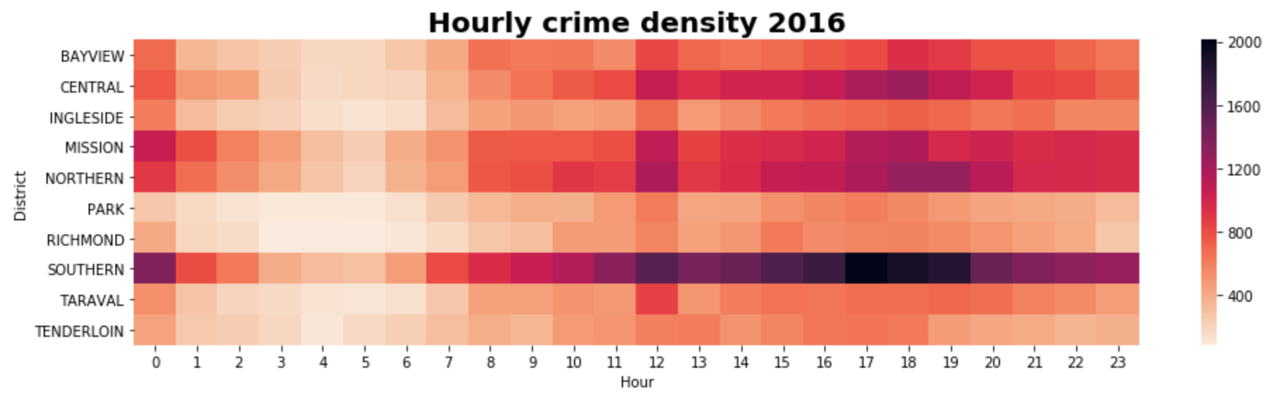
Hourly Trend

Slide 7
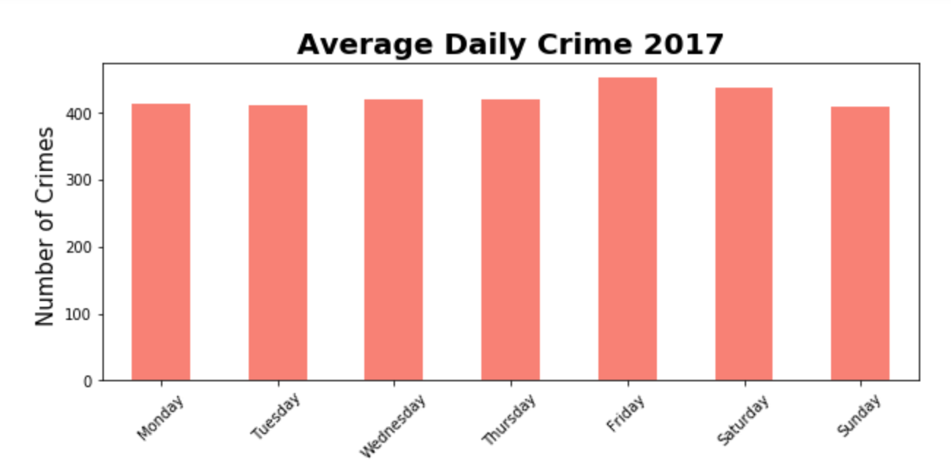
Daily Trend
2016
Ttest_statistic = 0.30372251276763623
Pvalue = 0.77159619088554254
2017
Ttest_statistic = 0.18995853708072147
Pvalue = 0.85560529543910158
Notes:
We use a one sample T-test to determine whether our sample mean (observed average for the days of the week) is statistically significantly different to the population mean (expected average).
The p-value in this case is 0.8556, which is Bigger than the standard thresholds of 0.05 or 0.01, so we accept the null hypothesis and we can say there isn't any statistically significant difference between the daily average per day of the week and the general daily average.
The p-value in this case is 0.7716, which is Bigger than the standard thresholds of 0.05 or 0.01, so we accept the null hypothesis and we can say there isn't any statistically significant difference between the daily average per day of the week and the general daily average.

Slide 8
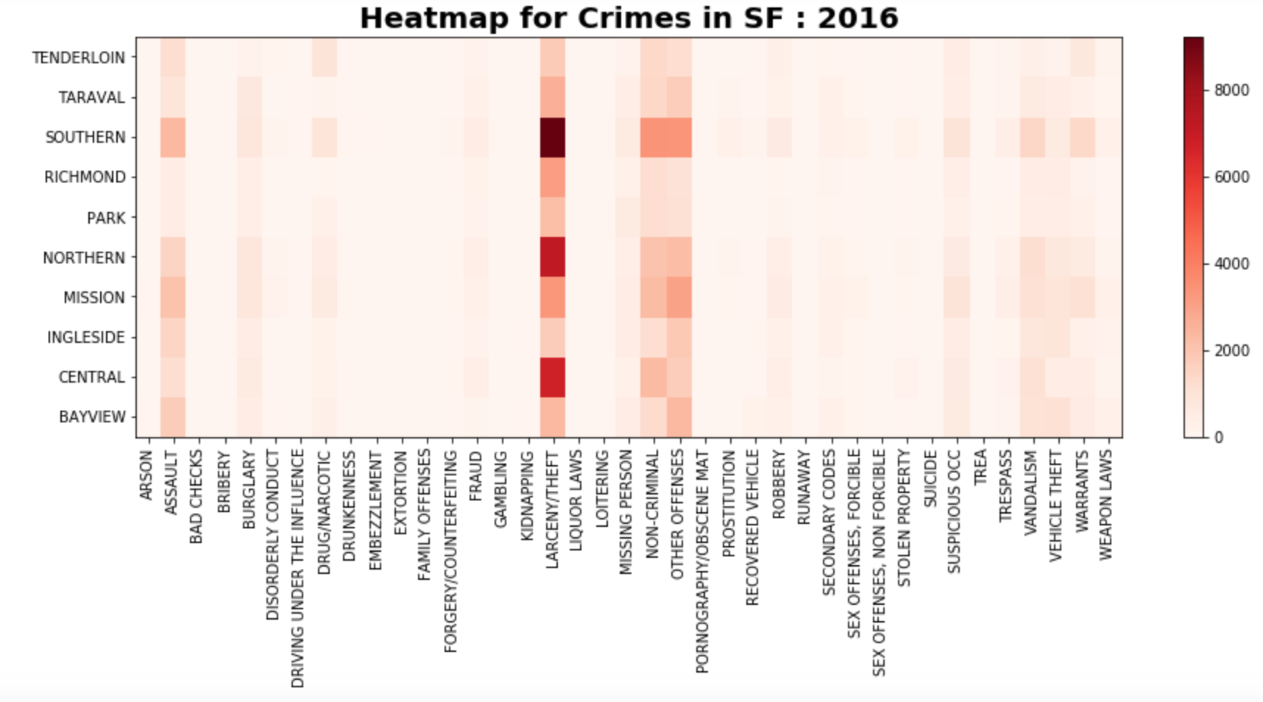
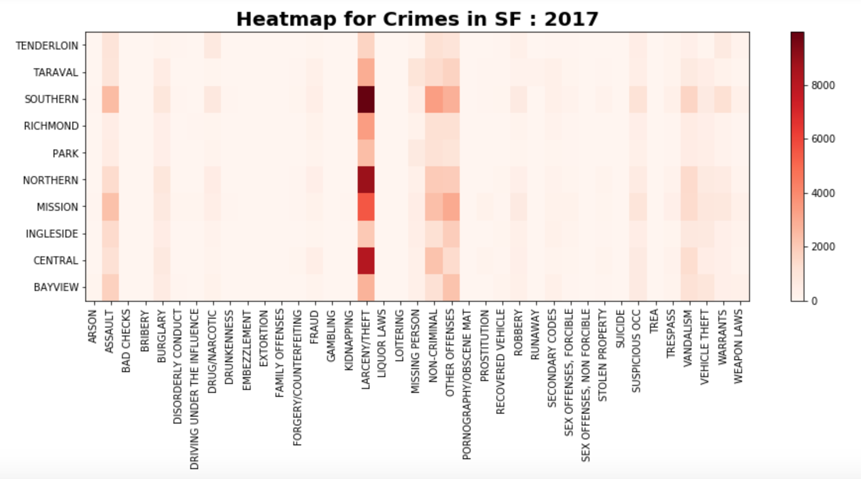
Crime Density by District

Slide 9
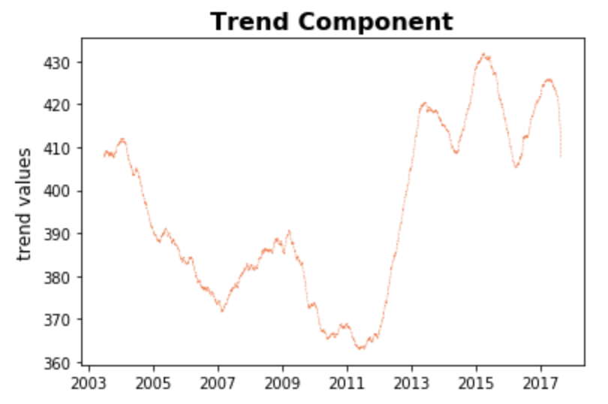
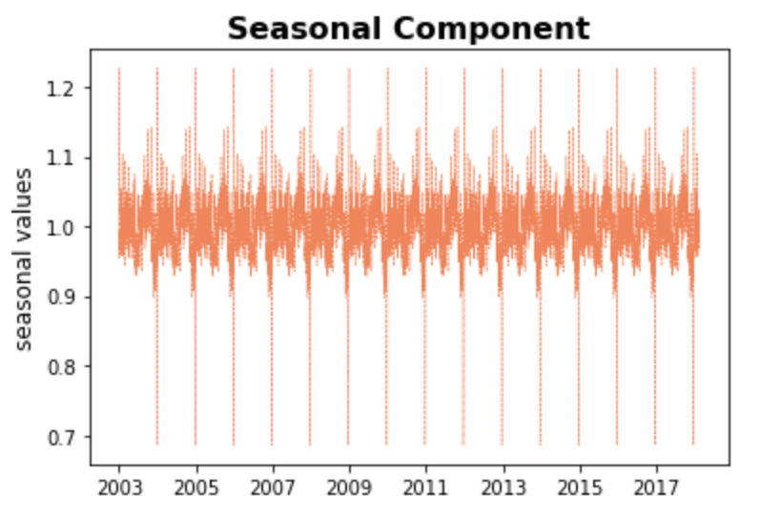
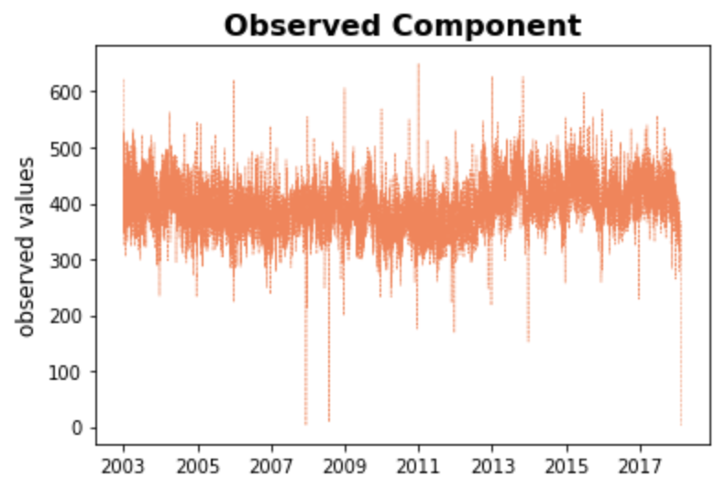
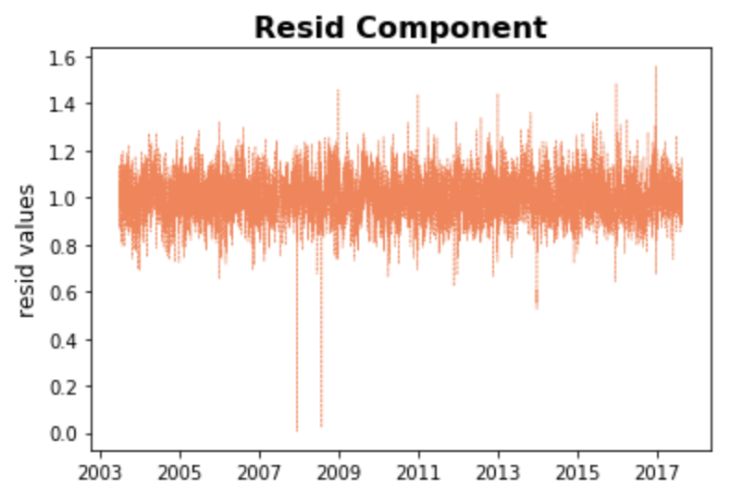
Yearly Trend

Slide 10
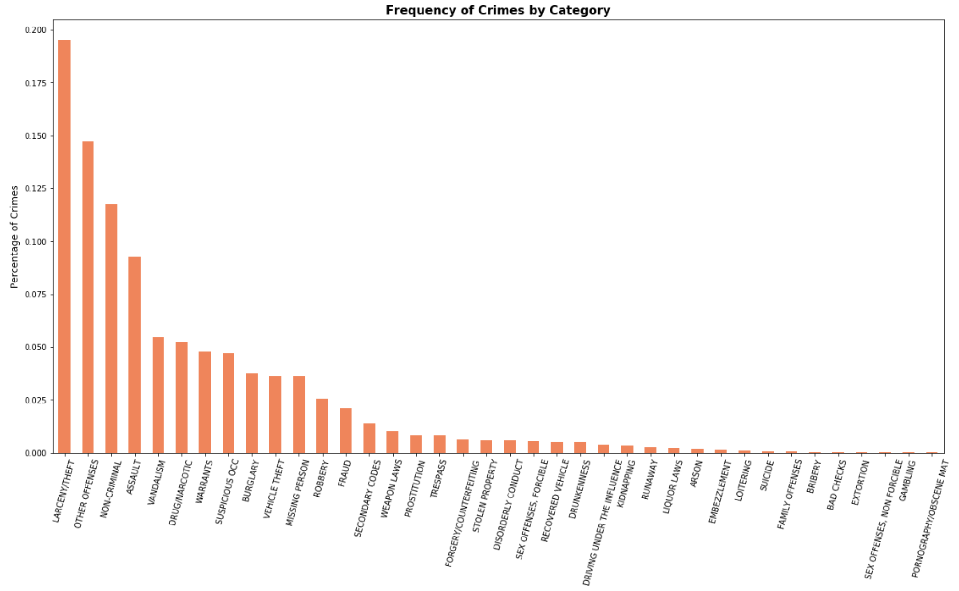
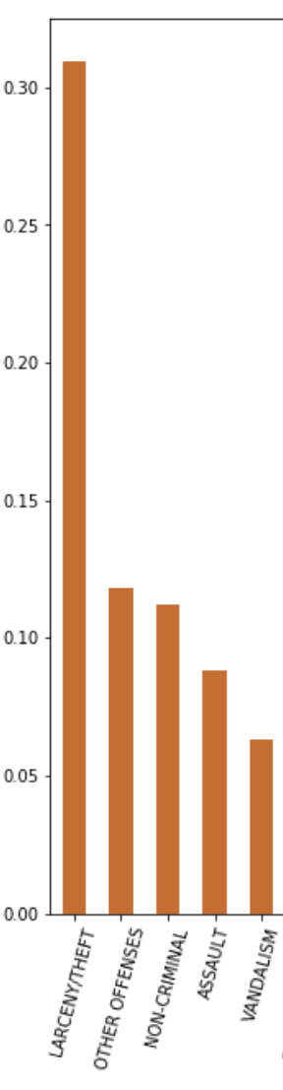
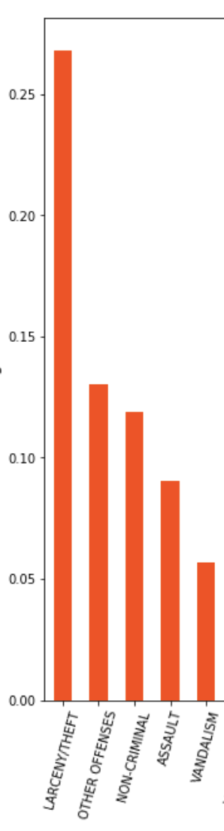
Yearly Trend
2011
2016
2017
I will input analysis.

Slide 11
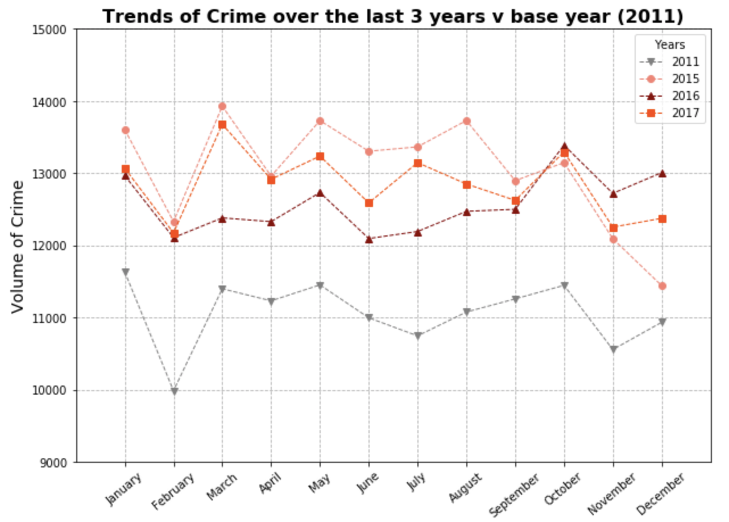
Yearly Trend
I will input analysis.

Slide 12
Yearly Trend

Slide 13
Unresolved Crimes : 2018

Slide 14
Unresolved-Arson Crimes : 2018

Slide 15
Vehicle Theft - 2018

Slide 16
Discussion
Safety levels: Most dangerous districts are Southern, Northern, and Central.
Most prevalent crime: Larceny and Theft
Hourly Trends: Safest- 4:00am-5:00 for all districts. Most dangerous- fairly scattered with 12:00 pm having highest crime rates
What inferences or general conclusions can you draw from your analysis?
…

Slide 17
Discussion (continued)
Daily Trends: t-test p-value indicates that the average number of daily crimes does not vary significantly across days of the week (2016-2017)

Slide 18
Post Mortem
Challenges:
Additional questions:

Slide 19
Thanks!
Any questions ?
You can find our fully analysis at
https://github.com/mitrapiya25/SF-Crime-Analysis

